Slide 1
AIML Time Series Forecasting
Singapore Polytechnic
P2112646
Justin Wong Juin Hng
Singapore Polytechnic

Slide 2
Table of contents
01.
03.
04.
02.
Singapore Polytechnic
Problem Breakdown
Modelling & Tuning
What are the requirements of the problem statement?
Initial Modelling and Hyperparameter Tuning
Conclusion
Data Manipulation & Exploration
Conclusion of Insights
Data Cleaning, Feature Engineering and Exploratory Data Analysis (EDA)
Singapore Polytechnic

Slide 3
01.
Problem Breakdown
Singapore Polytechnic
What are the requirements of the problem statement?
Singapore Polytechnic

Slide 4
Problem
Singapore Polytechnic
Using air-pollution dataset to train a time series model for future air pollution forecasting.
Singapore Polytechnic

Slide 5
02.
Data Manipulation & Exploration
Singapore Polytechnic
Data Cleaning, Feature Engineering and Exploratory Data Analysis (EDA)
Singapore Polytechnic

Slide 6
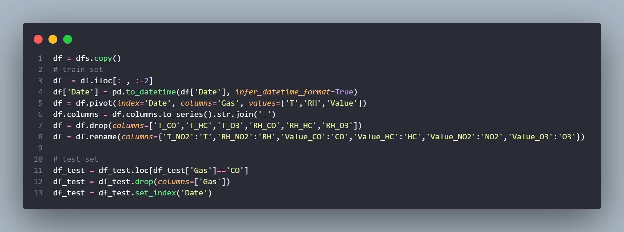
Splitting Data
Singapore Polytechnic
Creating new features to enhance accuracy of model and increase relevance of data.
We split the DataFrame into 2 sets:
Train Data
Evaluation Data
This train-test split procedure is used to estimate the performance of machine learning algorithms when they are used to make predictions on data not used to train the model. (Brownlee, 2020)
Singapore Polytechnic

Slide 7
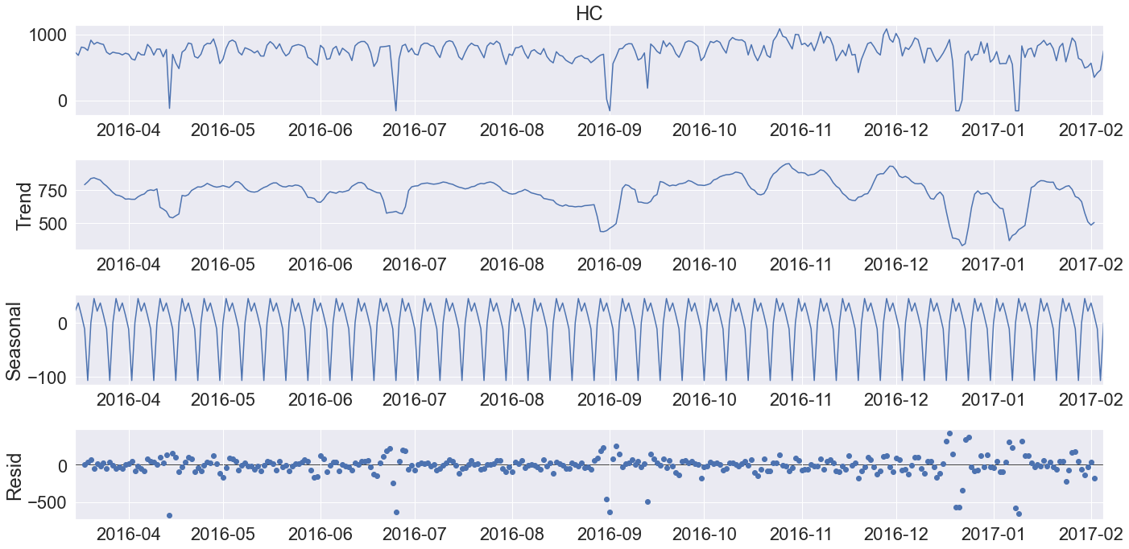
Data Exploration
Singapore Polytechnic
ETS (Error/Trend/Seasonality) Model
ETS model describes the time series data by decomposing the data into 3 components: trend, seasonality, and errors. (Jie, 2021)
There are 2 models available for ETS, Additive and Multiplicative.
Additive: applicable when the trend and seasonality components are constant (or linear) over time.
Multiplicative: applicable when the trend increasing or decreasing is at a non-linear rate.
Singapore Polytechnic

Slide 8
Data Exploration
Singapore Polytechnic
ETS (Error/Trend/Seasonality) Model
ETS model describes the time series data by decomposing the data into 3 components: trend, seasonality, and errors. (Jie, 2021)
There are 2 models available for ETS, Additive and Multiplicative.
Additive: applicable when the trend and seasonality components are constant (or linear) over time.
Multiplicative: applicable when the trend increasing or decreasing is at a non-linear rate.
Singapore Polytechnic

Slide 9
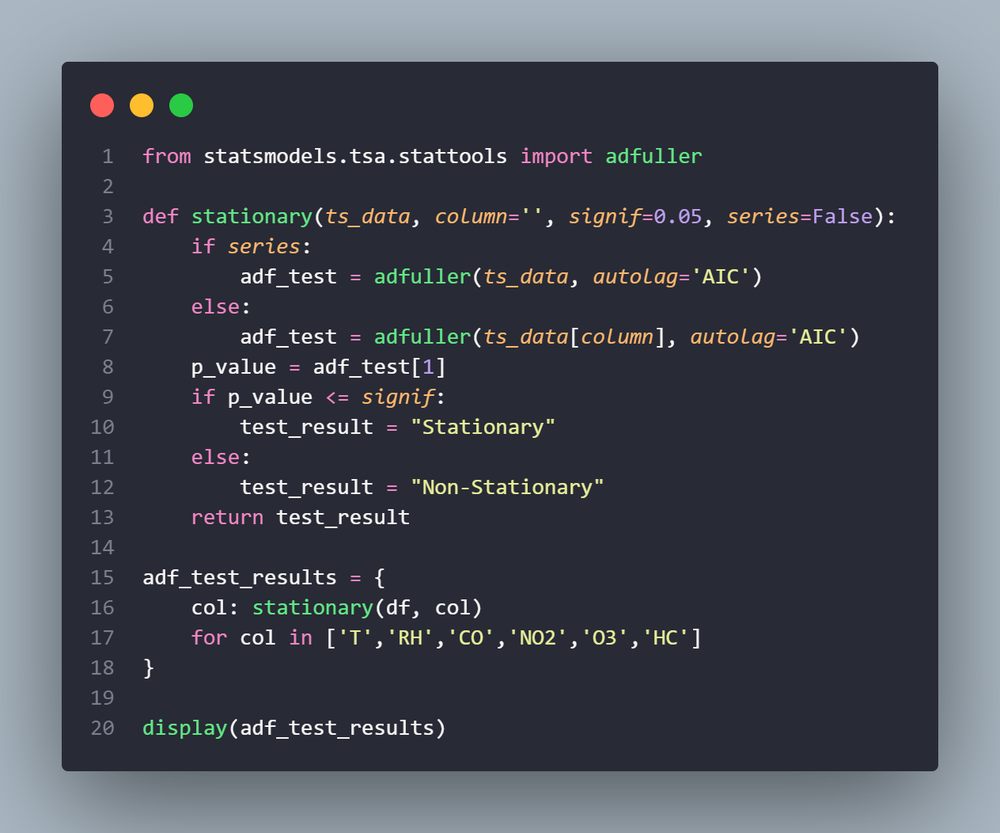
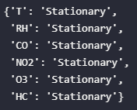
Singapore Polytechnic
Augmented Dickey-Fuller Test for Stationarity
Augmented Dickey Fuller test (ADF Test) is a common statistical test used to test whether a given Time series is stationary or not. It is one of the most commonly used statistical test when it comes to analyzing the stationary of a series. (Prabhakaran, 2019)
Singapore Polytechnic

Slide 10
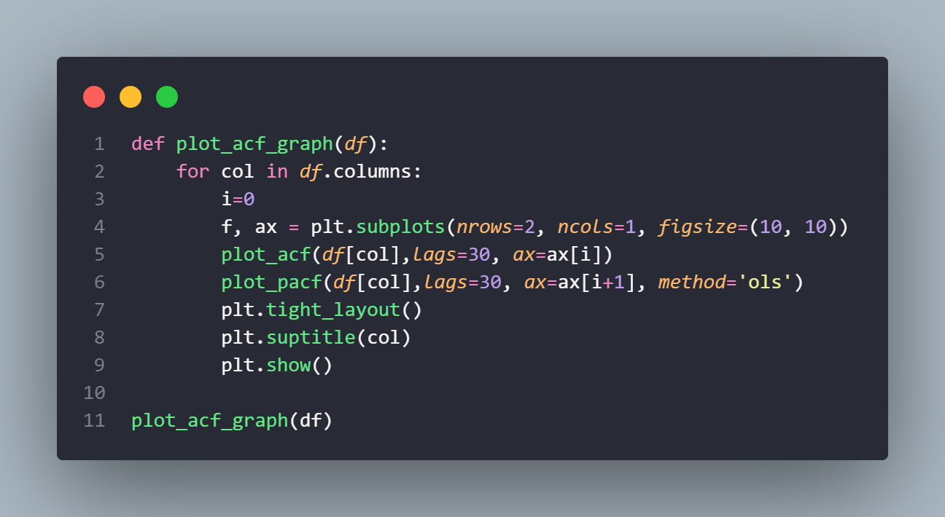
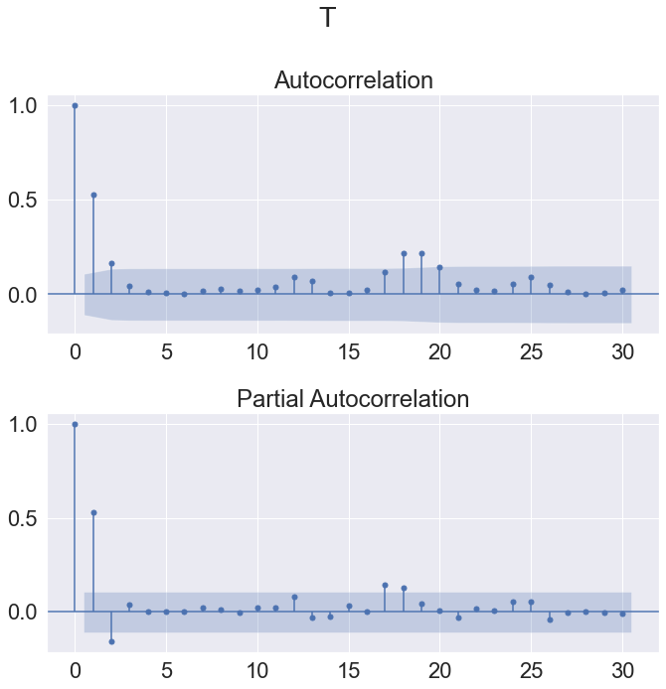
Singapore Polytechnic
Autocorrelation Function (ACF)
Correlation between time series with a lagged version of itself. The correlation between the observation at the current time spot and the observations at previous time spots.The autocorrelation function starts a lag 0, which is the correlation of the time series with itself and therefore results in a correlation of 1. We will be using the plot_acf function from the statsmodels.graphics.tsaplots library. (See statsmodels.tsa.stattools.acf)
The ACF plot can provide answers to the following questions:
Is the observed time series white noise / random?
Is an observation related to an adjacent observation, an observation twice-removed, and so on?
Can the observed time series be modeled with an MA model? If yes, what is the order?
Analysis:
All autocorrelations are significantly non-zero. Therefore, the time series is non-random.
Singapore Polytechnic

Slide 11
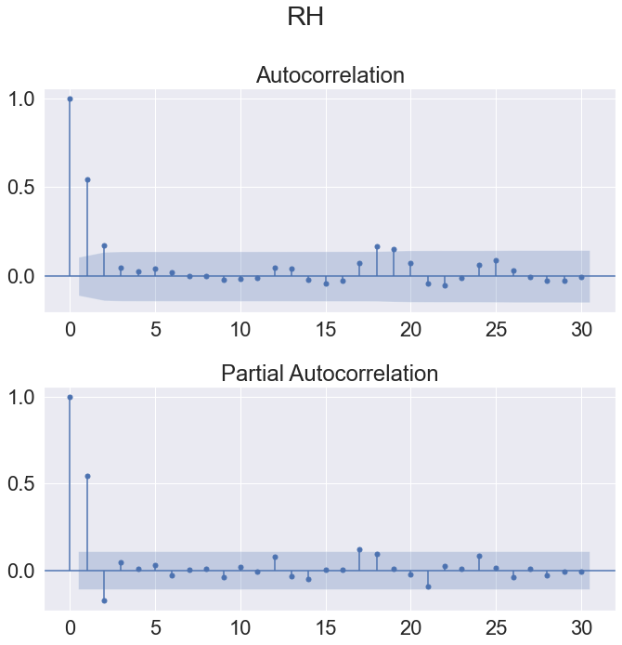
Singapore Polytechnic
Partial Autocorrelation Function (PACF)
Additional correlation explained by each successive lagged term. The correlation between observations at two time spots given that we consider both observations are correlated to observations at other time spots.
The partial autocorrelation at lag k is the autocorrelation between Xt and Xt−k that is not accounted for by lags 1 through k−1 .
We will be using the plot_pacf function from the statsmodels.graphics.tsaplots library with the parameter method = “ols” (regression of time series on lags of it and on constant). (See statsmodels.tsa.stattools.pacf)
Sidenote: The default parameter for method is yw (Yule-Walker with sample-size adjustment in denominator for acovf). However, this default value is causing some implausible autocorrelations higher than 1 on the sample data. Therefore, we change the method parameter to one that is not causing this issue.
The PACF plot can provide answers to the following questions:
Can the observed time series be modeled with an AR model? If yes, what is the order?
Singapore Polytechnic

Slide 12
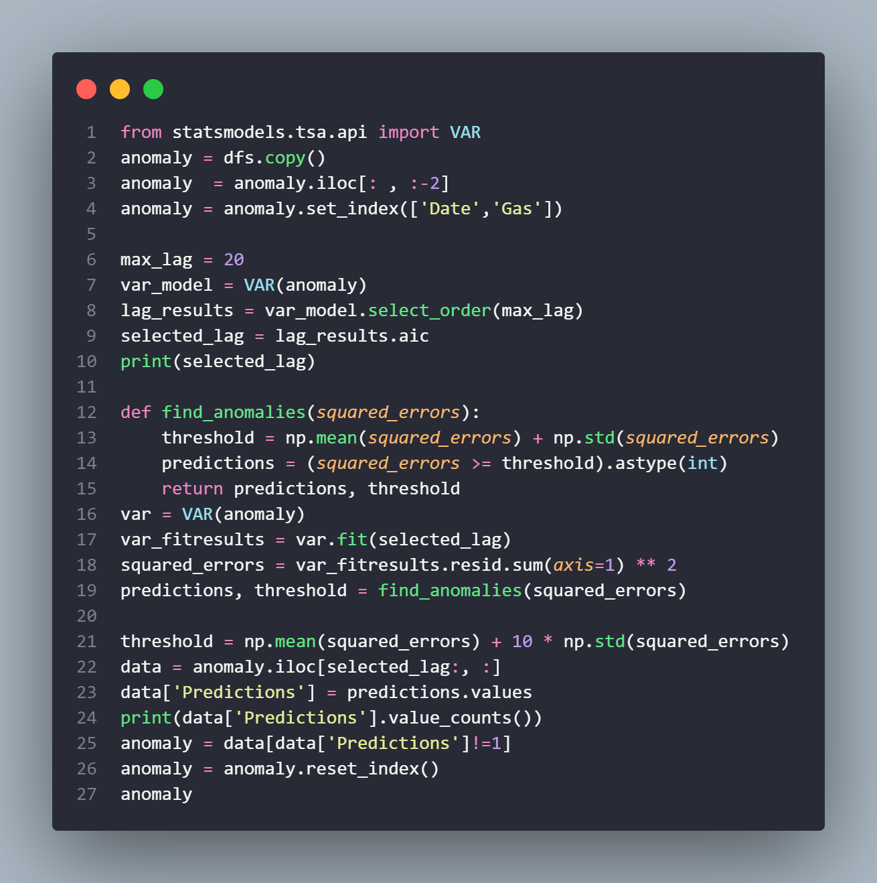
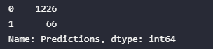
Singapore Polytechnic
Multivariate Anomaly Detection
To answer the question above, we need to understand the concepts of time-series data. Time-series data are strictly sequential and have autocorrelation, which means the observations in the data are dependant on their previous observations. If we use standard algorithms to find the anomalies in the time-series data we might get spurious predictions. So the time-series data must be treated specially. (Rajan, 2021)
Steps followed to detect anomalies in the time series data are,
Conduct an ADF test to check whether the data is stationary or not. If the data is not stationary convert the data into stationary data. (Rajan, 2021)
After converting the data into stationary data, fit a time-series model to model the relationship between the data. (Rajan, 2021)
Find the squared residual errors for each observation and find a threshold for those squared errors. Any observation’s squared error exceeding the threshold can be marked as an anomaly. The reason behind using this approach, (Rajan, 2021)
As stated earlier, the time-series data are strictly sequential and contain autocorrelation. By using the above approach the model would find the general behaviour of the data. The normal data’s prediction error would be much smaller when compared to anomalous data’s prediction error. (Rajan, 2021)
Since our data is stationary, we will proceed straight to the VAR model to handle multivariate anomaly detection
This means that there were 66 anomalies detected.
Singapore Polytechnic

Slide 13
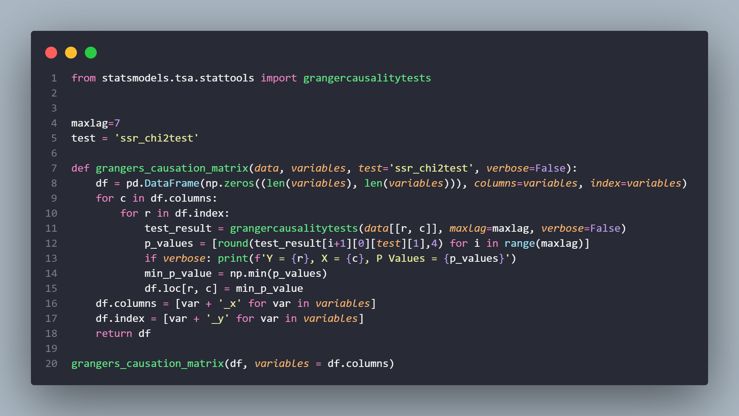
Singapore Polytechnic
Granger’s Causality Test
The Granger Causality test is used to determine whether or not one time series is useful for forecasting another.
This can be used to determine whether the Temperature and RH time series are useful for forecasting the different gases.
Singapore Polytechnic

Slide 14
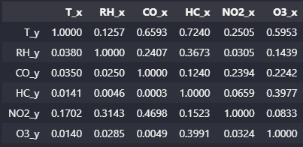
Singapore Polytechnic
Analysis:
We can observe that Temperature Granger causes:
1. Relative Humidity
2. CO Amount
3. HC Amount
4. O3 Amount
We can also observe Relative Humidity Granger Causes:
1. CO Amount
2. HC Amount
3. O3 Amount
Interesting observations are that Temperature causes Relative Humidity but the converse is not true.
This may be due to the fact that the dataset given is based on an Italian City.
Since Italy is surrounded by a body of water, the shortwave radiation from the Sun may hit the ocean water and cause the water to evaporate and increase the content of water vapour in the air. And when the temperature increases, the warmer air needs more moisture to reach its saturation point, while colder air has a much lower saturation threshold—it's relative to the current temperature. Hence, temperature causes relative humidity.
We can observe a common occurrence in that NO2 is not present in either the causation of temperature or relative humidity.
This is due to the fact that Nitrogen Dioxide (NO2) is actually produced by the burning of fuel. NO2 forms from emissions from cars, trucks and buses, power plants, and off-road equipment. (US EPA,OAR, 2016)
However, according to a study in 2019, Chinese scientists conducted a study on the effect of temperature and relative humidity on NO2 Pollution (Negative levels of NO2 present in the air). The findings suggested that season and temperature strongly modified the adverse effects of NO2: in the cold season and on days with low temperatures, the adverse effect of NO2 on cardiovascular mortality was significantly enhanced. (Duan et al., 2019)
Hence, we will depend on the findings of the model to interpret this relationship.

Slide 15
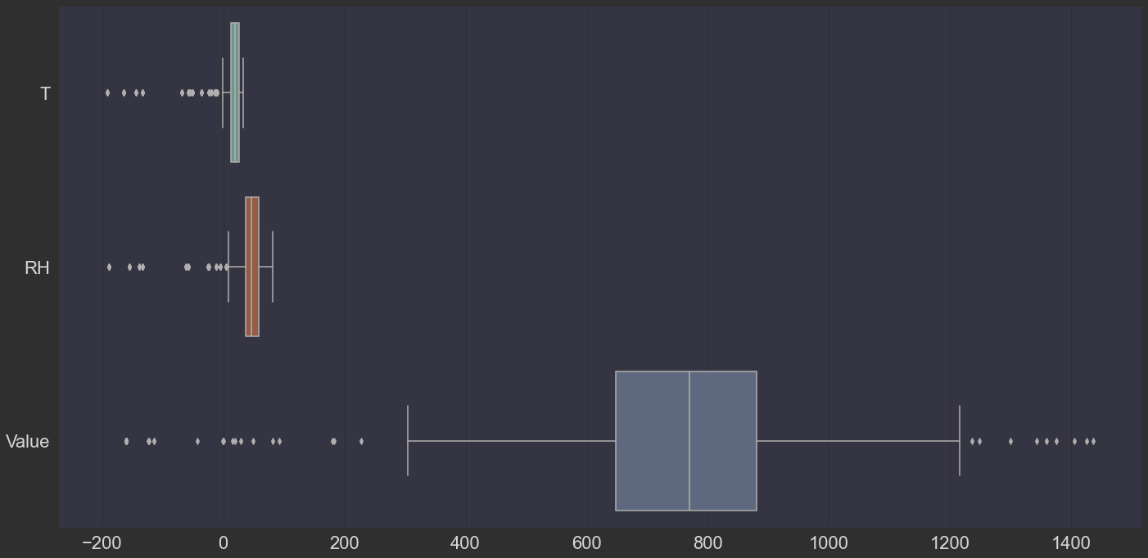
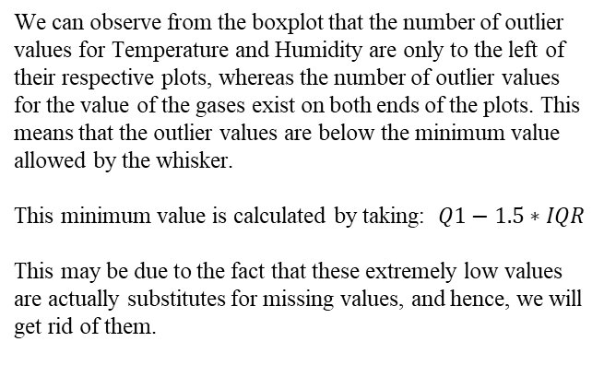
Singapore Polytechnic
We can observe from the boxplot that the number of outlier values for Temperature and Humidity are only to the left of their respective plots, whereas the number of outlier values for the value of the gases exist on both ends of the plots. This means that the outlier values are below the minimum value allowed by the whisker.
This minimum value is calculated by taking: $Q1−1.5∗IQR$
This may be due to the fact that these extremely low values are actually substitutes for missing values, and hence, we will get rid of them.
Singapore Polytechnic

Slide 16
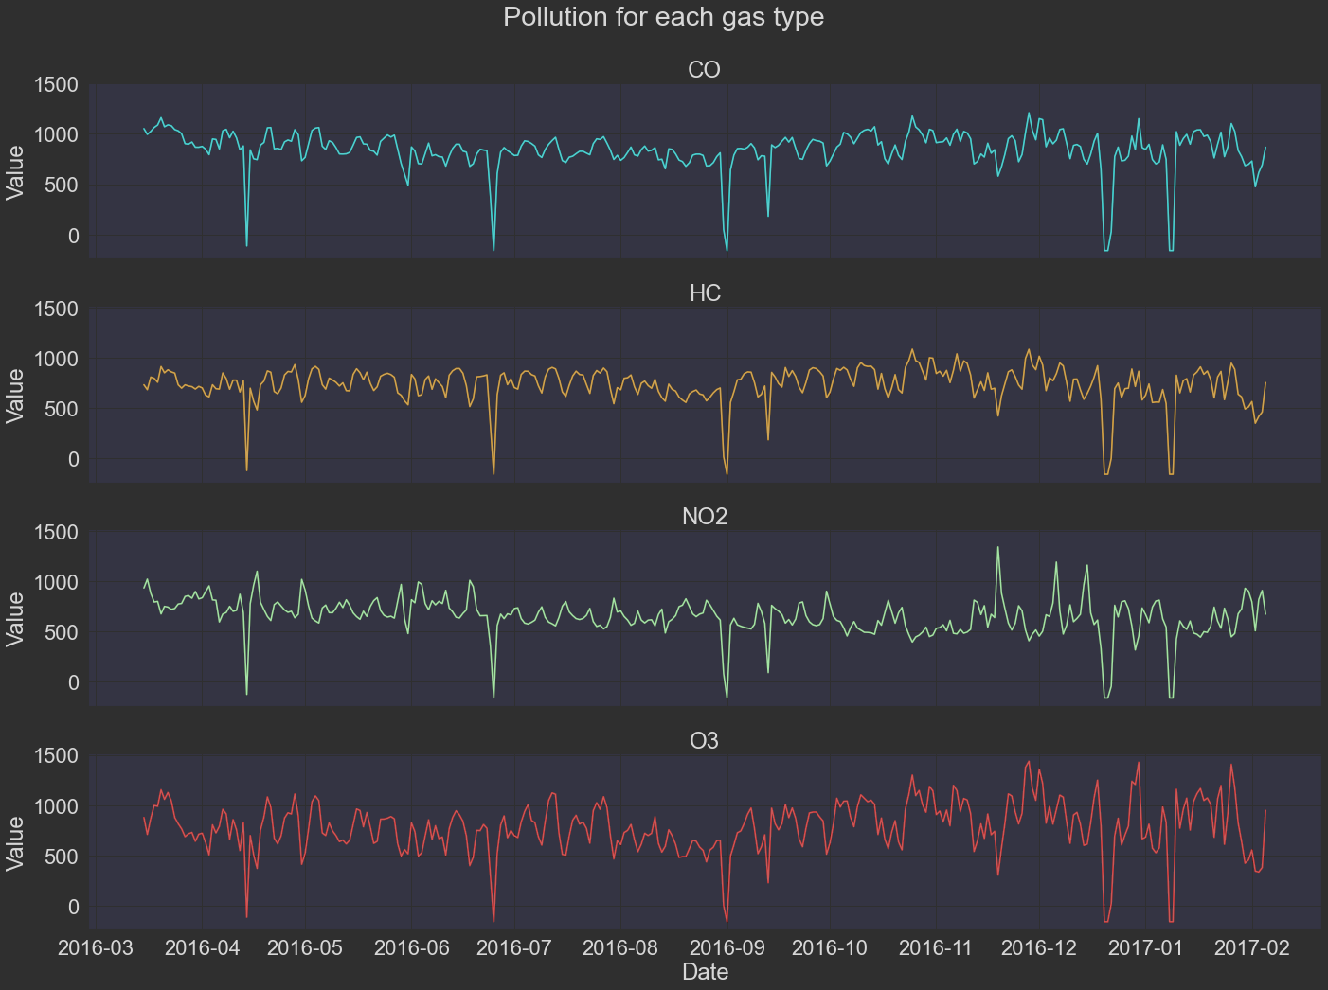
Singapore Polytechnic
Additionally, when we analyse the shapes of the graphs for the value of each gas, we can see that the shapes of CO and HC are similar to each other, whereas the shapes of NO2 and O3 are different.
This may be due to the different factors that are responsible for the production of these gases. We will dive deeper into this later.
Singapore Polytechnic

Slide 17
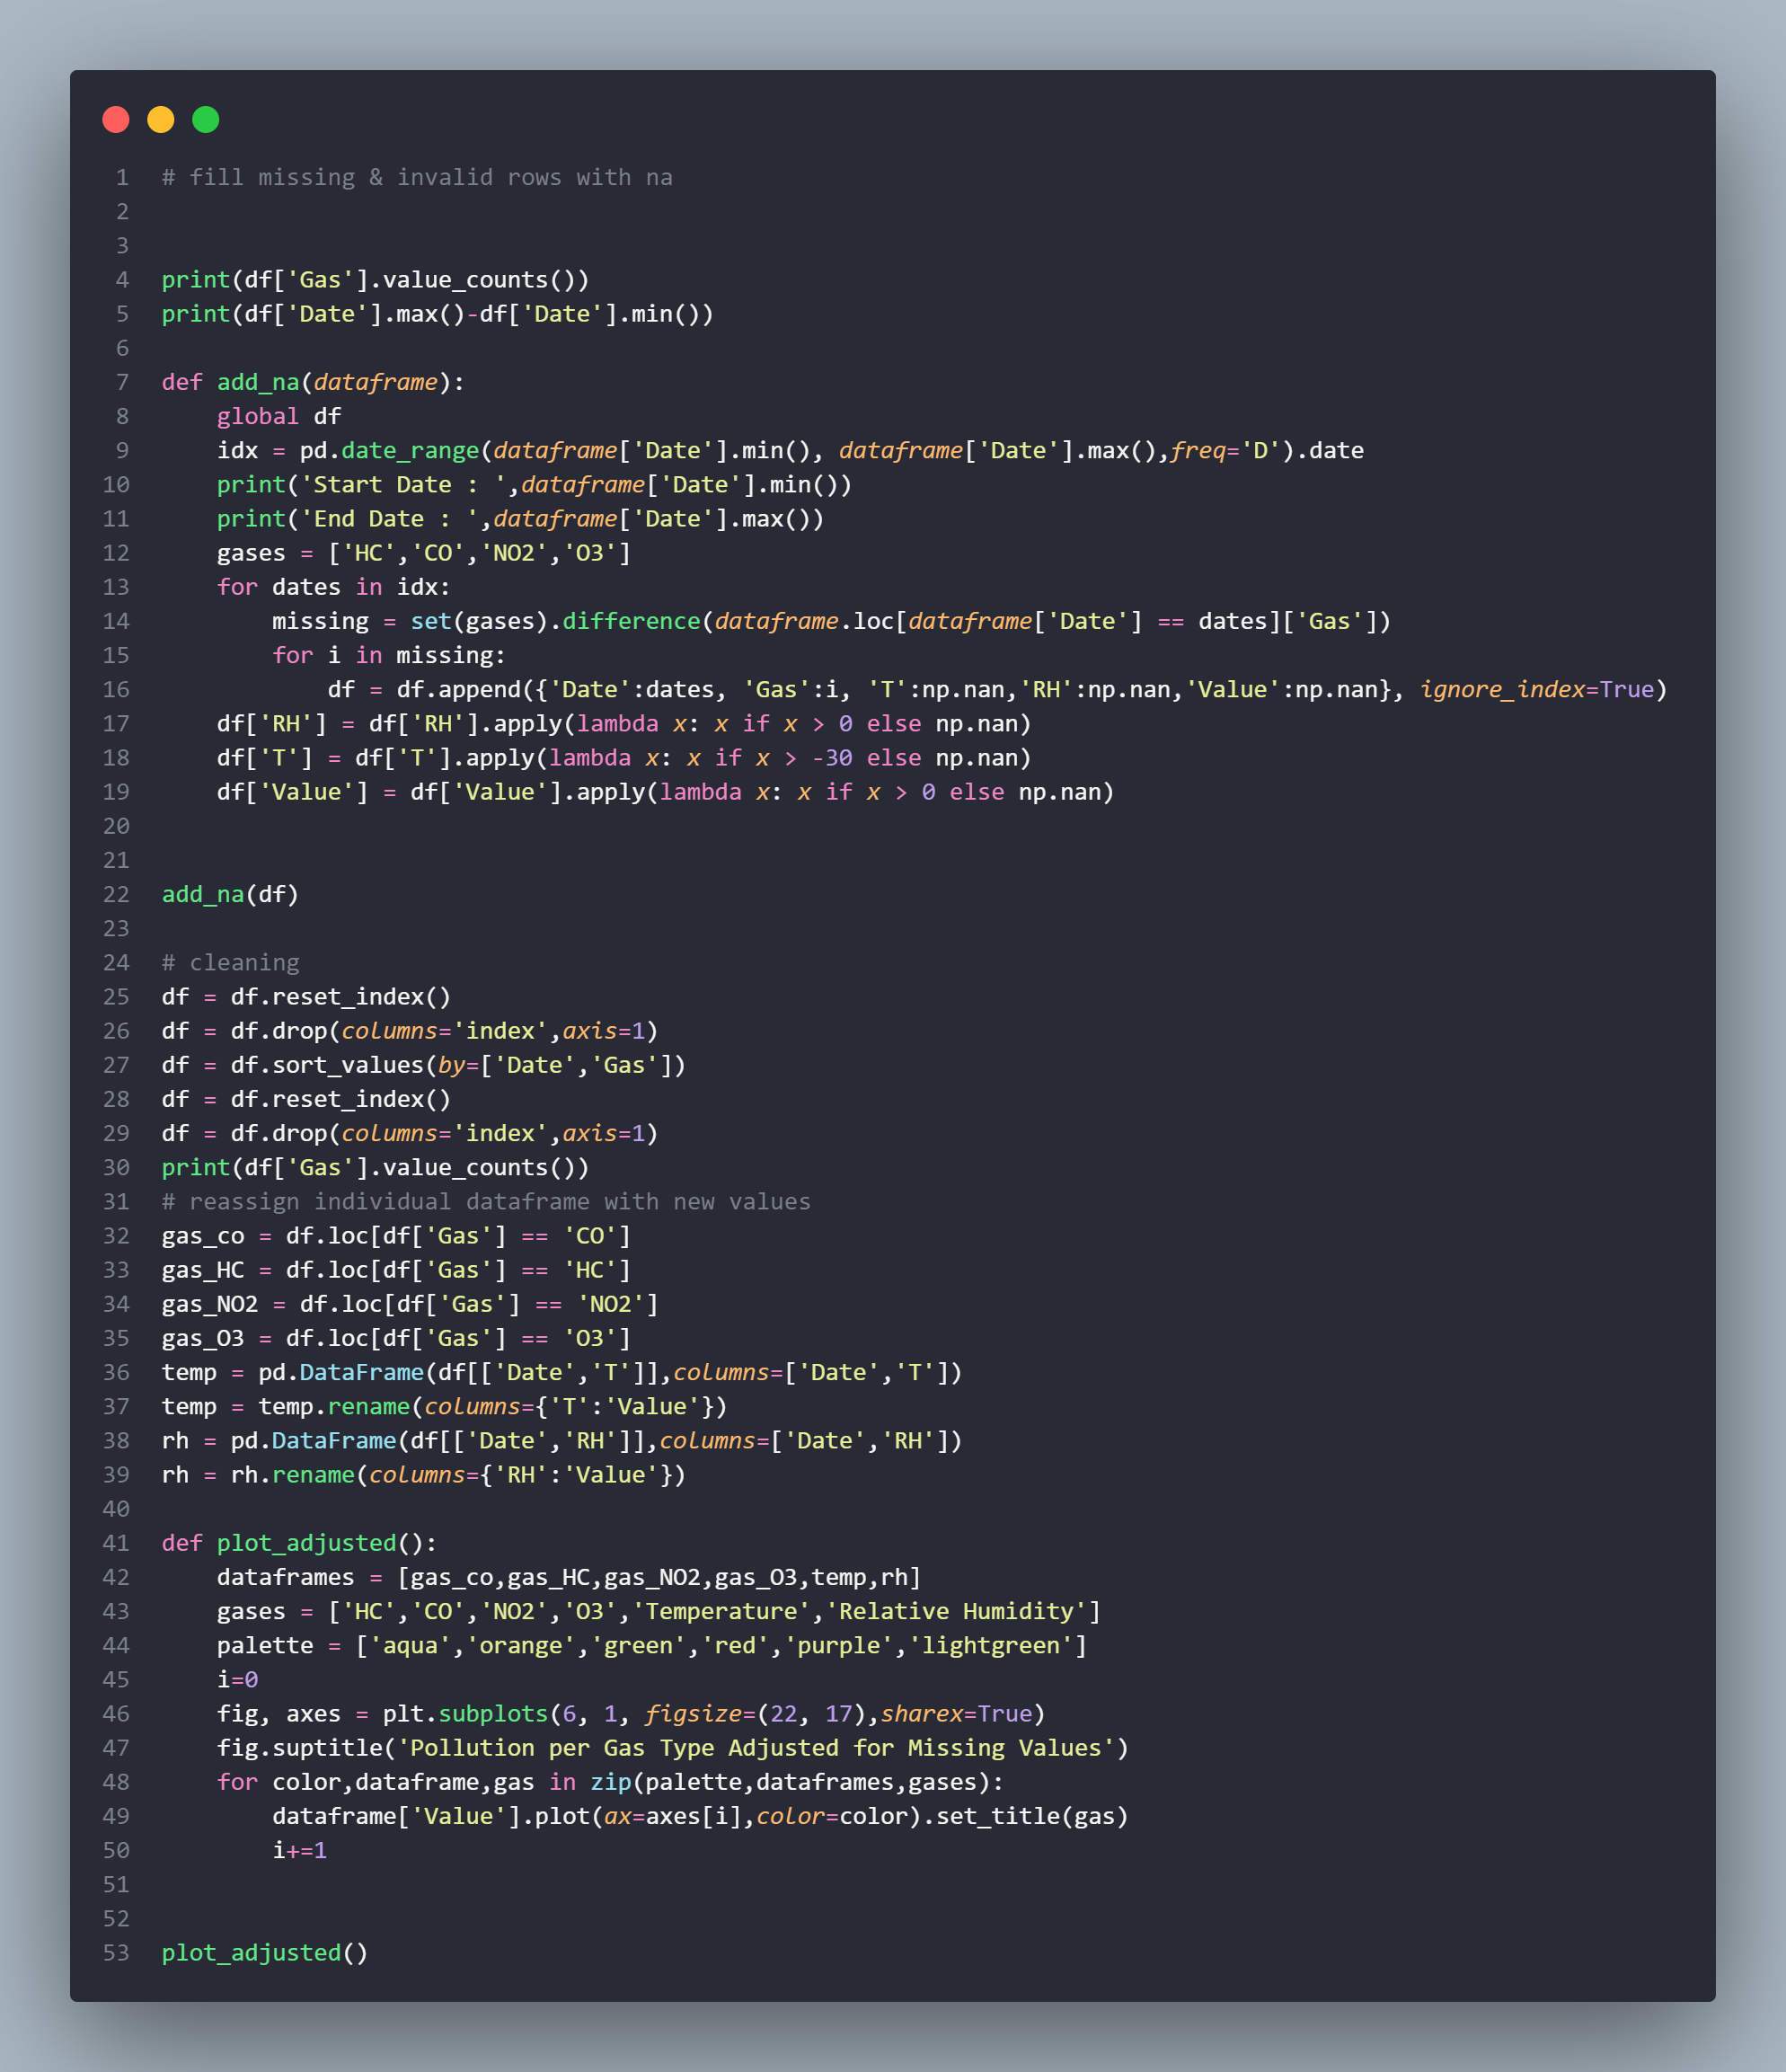
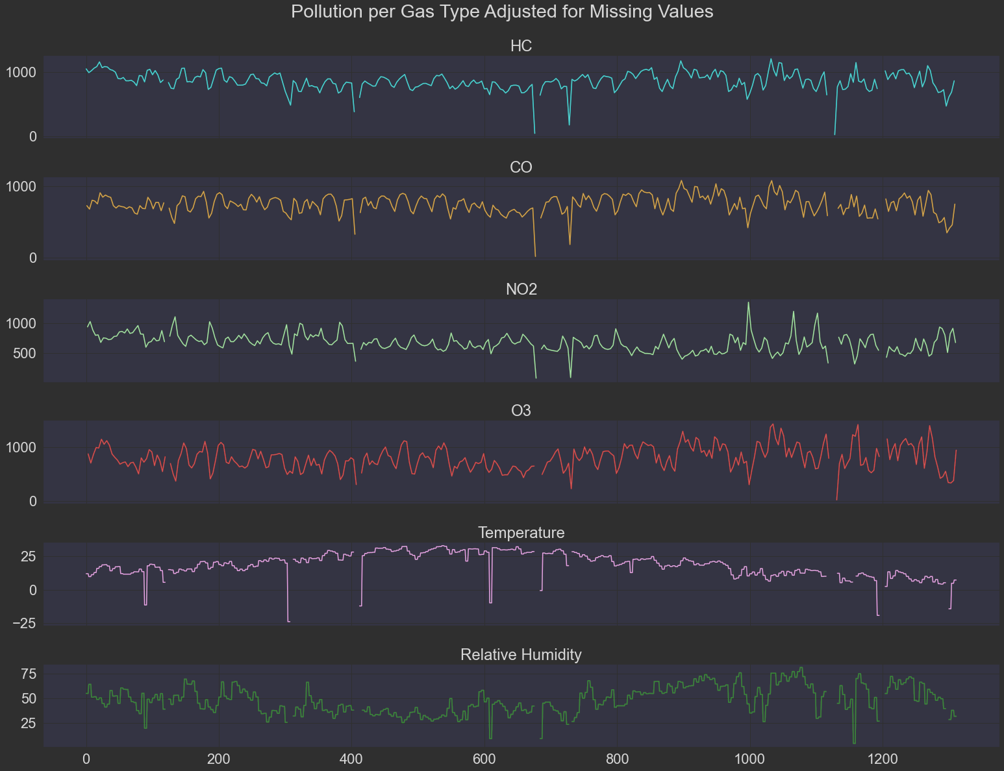
Handling Missing Data
Singapore Polytechnic
We remove the rows of Relative Humidity if RH is < 0, and since the dataset is sourced from an Italian city, we know that the average lowest temperature in an Italian city is -30 degrees Celsius, we remove the rows of temperature if it is < 30
Singapore Polytechnic

Slide 18
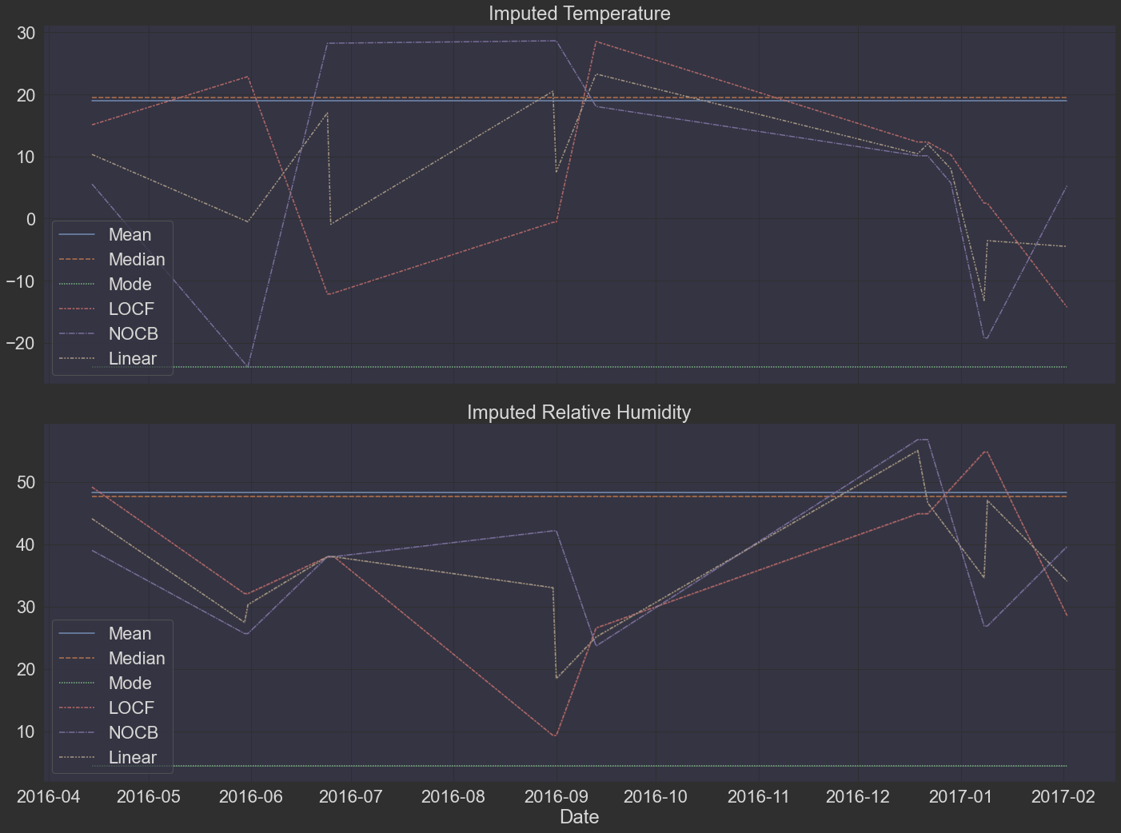
Imputing Data
Singapore Polytechnic
Imputing Time Series Data with using different methods found in scikit library
Methods:
Mean imputation
Median imputation
Last Observation Carried Forward(LOCF)
Next Observation Carried Backward(NOCB)
Linear interpolation (rolling window)
Spline interpolation (polynomial interpolation)
Singapore Polytechnic

Slide 19
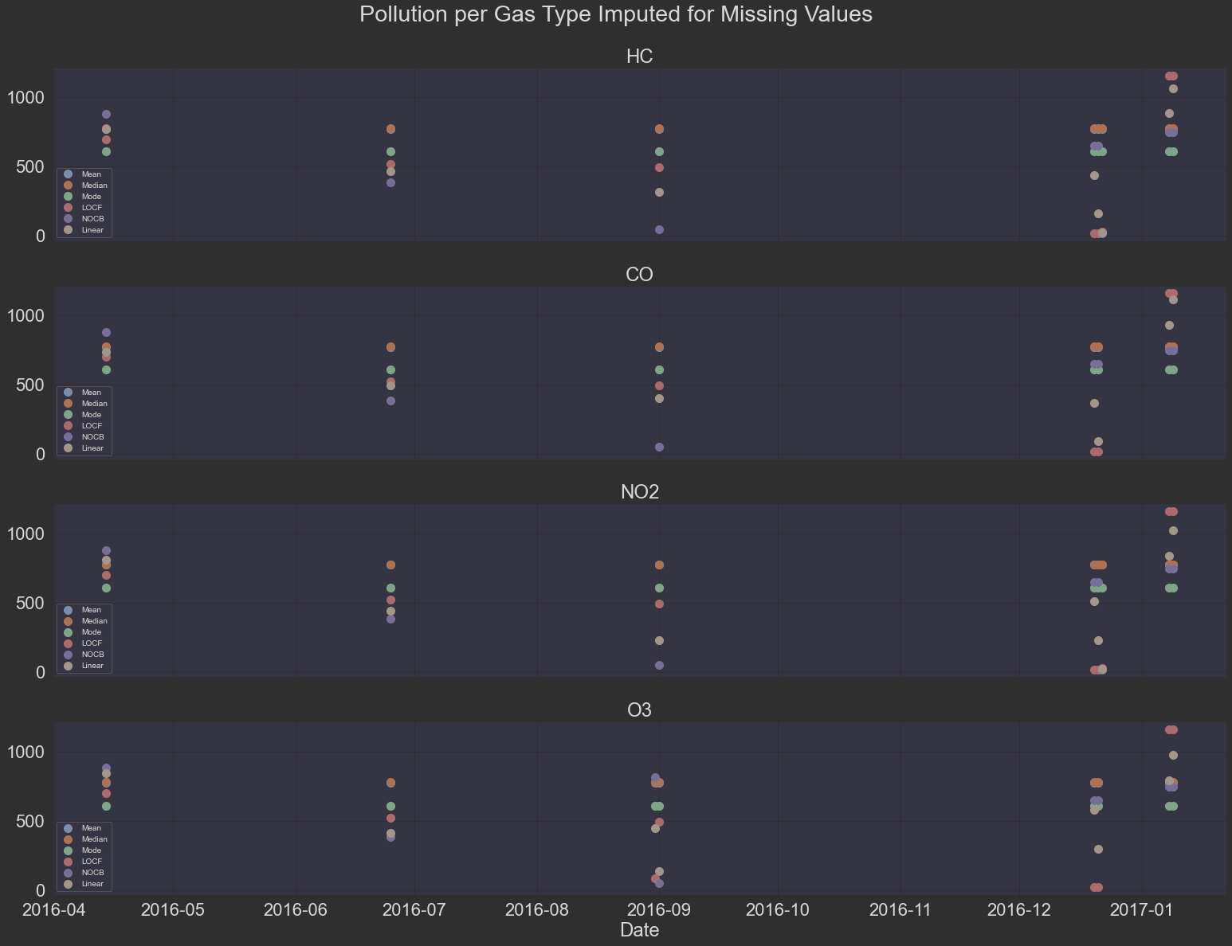
Imputing Data
Singapore Polytechnic
Imputing Time Series Data with using different methods found in scikit library
Methods:
Mean imputation
Median imputation
Last Observation Carried Forward(LOCF)
Next Observation Carried Backward(NOCB)
Linear interpolation (rolling window)
Spline interpolation (polynomial interpolation)
Singapore Polytechnic

Slide 20
03.
Modelling & Tuning
Singapore Polytechnic
Baseline, Initial Modelling and Hyperparameter Tuning
Singapore Polytechnic

Slide 21
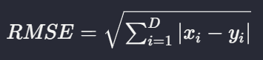
Evaluation Metrics
Singapore Polytechnic
Root Mean Squared Error (RMSE)
Take the difference between your model’s predictions and test values, square it, and average it out across the whole dataset.
Advantage: RMSE is great for ensuring that our trained model has no outlier predictions with huge errors, since the RMSE puts larger weight on these errors due to the squaring part of the function.
Disadvantage: If our model makes a single very bad prediction, the squaring part of the function magnifies the error. Yet in many practical cases we don’t care much about these outliers and are aiming for more of a well-rounded model that performs good enough on the majority.
Since our model doesn’t have any outlier values, we can safely proceed to using RMSE
(Seif, 2022)
Singapore Polytechnic

Slide 22
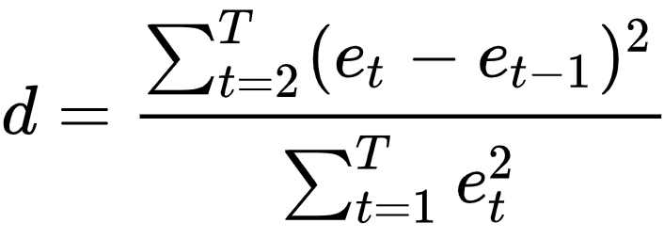
Evaluation Metrics
Singapore Polytechnic
Durbin-Watson Test Statistic
"The Durbin-Watson statistic lies in the range 0-4. A value of 2 or nearly 2 indicates that there is no first-order autocorrelation. An acceptable range is 1.50 - 2.50.“
(https://help.sap.com/saphelp_SCM700_ehp02/helpdata/en/e8/3cc95360267614e10000000a174cb4/content.htm?no_cache=true)
(Defaux, 2020)
Singapore Polytechnic

Slide 23
Models Used
Singapore Polytechnic
We will explore the baseline statistical models used with time-series data along with multivariate time-series models as we have more than 2 columns (Time, Target Variable)
Model exploration will be able to give us a good representation and comparison of the performance of each model.
Exponential Smoothing
Vector Autoregressions (VAR) note (Forecast Error Variance Decomposition (FEVD))
Vector Moving Average (VMA)
Vector Auto-Regressive Integrated Moving Average (VARIMA)
Vector Error Correction Model (VECM)
Seasonal Auto-Regressive Integrated Moving Average with eXogenous factors (SARIMAX)
Vector Autoregressive Moving-Average processes with eXogenous regressors (VARMAX)
Singapore Polytechnic

Slide 24
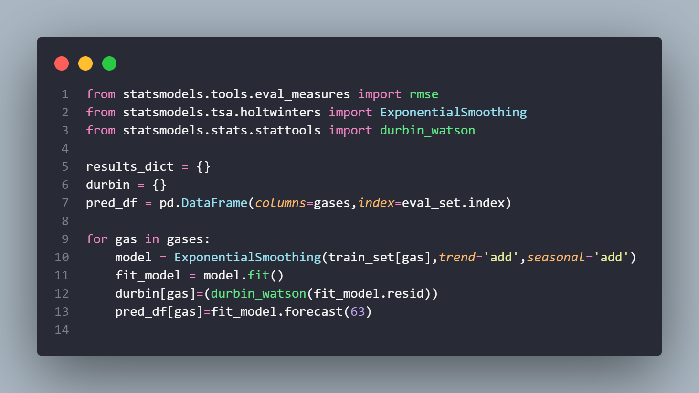
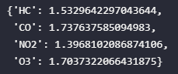
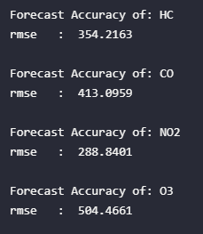
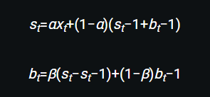
Holt-Winter Exponential Smoothing Model
Singapore Polytechnic
The Holt-Winters method uses exponential smoothing to encode lots of values from the past and use them to predict “typical” values for the present and future. Exponential smoothing refers to the use of an exponentially weighted moving average (EWMA) to “smooth” a time series
How does it work?
It consists of two EWMAs: one for the smoothed values of xt, and another for its slope. The terms level and trend are also used.
Durbin-Watson Test Statistic
Singapore Polytechnic

Slide 25
Holt-Winter Exponential Smoothing Model
Singapore Polytechnic
The Holt-Winters method uses exponential smoothing to encode lots of values from the past and use them to predict “typical” values for the present and future. Exponential smoothing refers to the use of an exponentially weighted moving average (EWMA) to “smooth” a time series
How does it work?
It consists of two EWMAs: one for the smoothed values of xt, and another for its slope. The terms level and trend are also used.
Durbin-Watson Test Statistic
Singapore Polytechnic

Slide 26
Holt-Winter Exponential Smoothing Model
Singapore Polytechnic
The Holt-Winters method uses exponential smoothing to encode lots of values from the past and use them to predict “typical” values for the present and future. Exponential smoothing refers to the use of an exponentially weighted moving average (EWMA) to “smooth” a time series
How does it work?
It consists of two EWMAs: one for the smoothed values of xt, and another for its slope. The terms level and trend are also used.
Durbin-Watson Test Statistic
Singapore Polytechnic

Slide 27
Holt-Winter Exponential Smoothing Model
Singapore Polytechnic
The Holt-Winters method uses exponential smoothing to encode lots of values from the past and use them to predict “typical” values for the present and future. Exponential smoothing refers to the use of an exponentially weighted moving average (EWMA) to “smooth” a time series
How does it work?
It consists of two EWMAs: one for the smoothed values of xt, and another for its slope. The terms level and trend are also used.
Durbin-Watson Test Statistic
Singapore Polytechnic

Slide 28
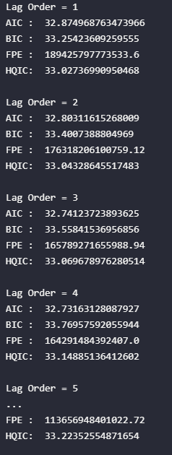
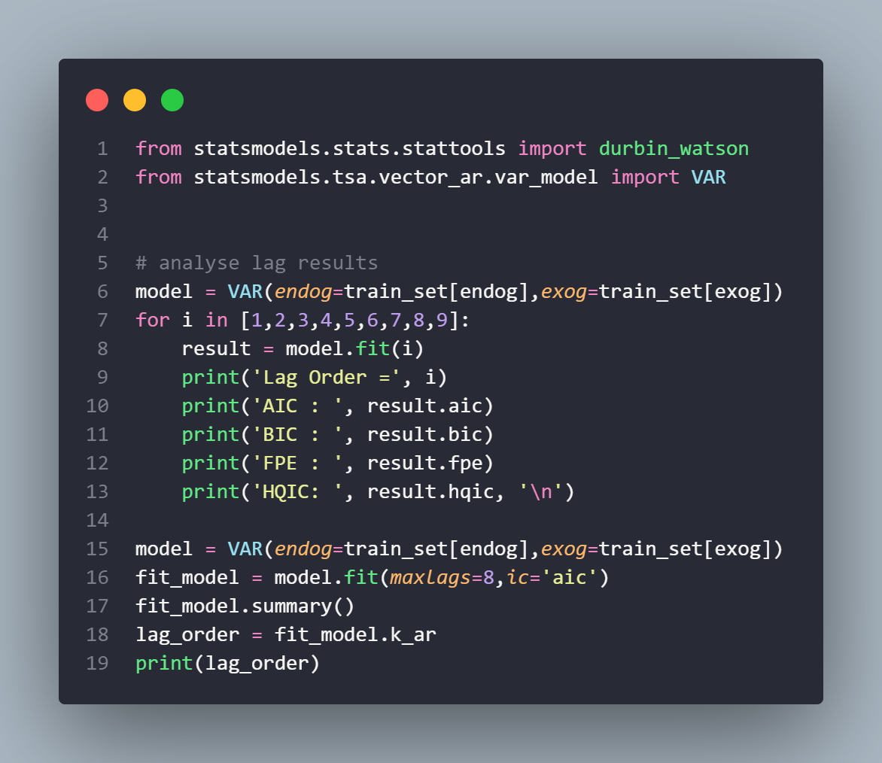
Vector Autoregressive (VAR) Model
Singapore Polytechnic
The vector autoregressive (VAR) model is a workhouse multivariate time series model that relates current observations of a variable with past observations of itself and past observations of other variables in the system.
Singapore Polytechnic

Slide 29
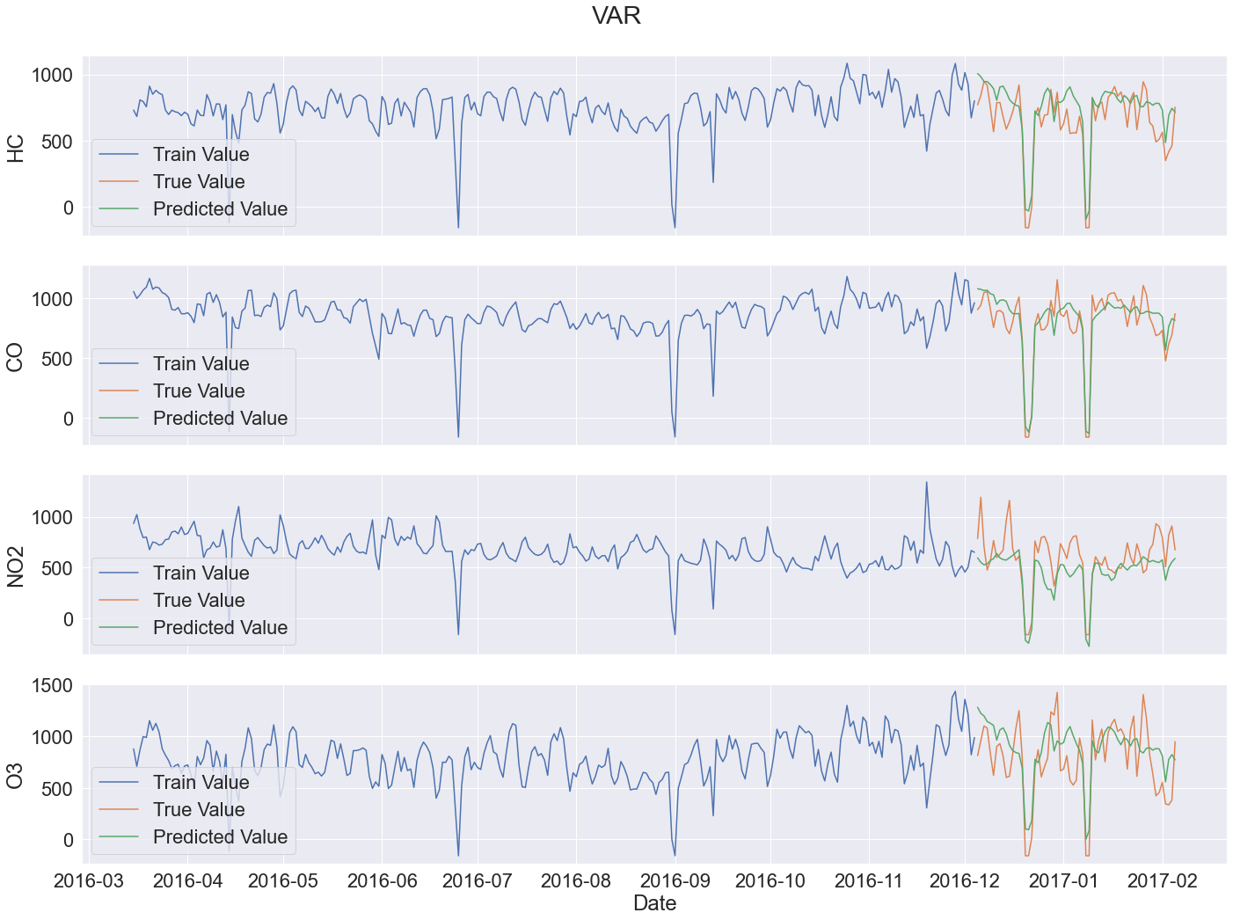
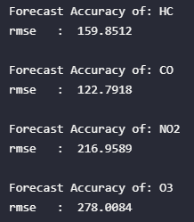
Singapore Polytechnic
To select the right order of the VAR model, we fit increasing orders of lag onto the VAR model and pick the order that gives a model with the least AIC.
In this case, we can see that the lowest `lag` = `8`.
Hence, we lag the data by 8 days and forecast it onto the VAR Model.
We get the RMSE of all gases being above 120, meaning the VAR model is not good.
RMSE
Durbin-Watson Test Statistic

Slide 30
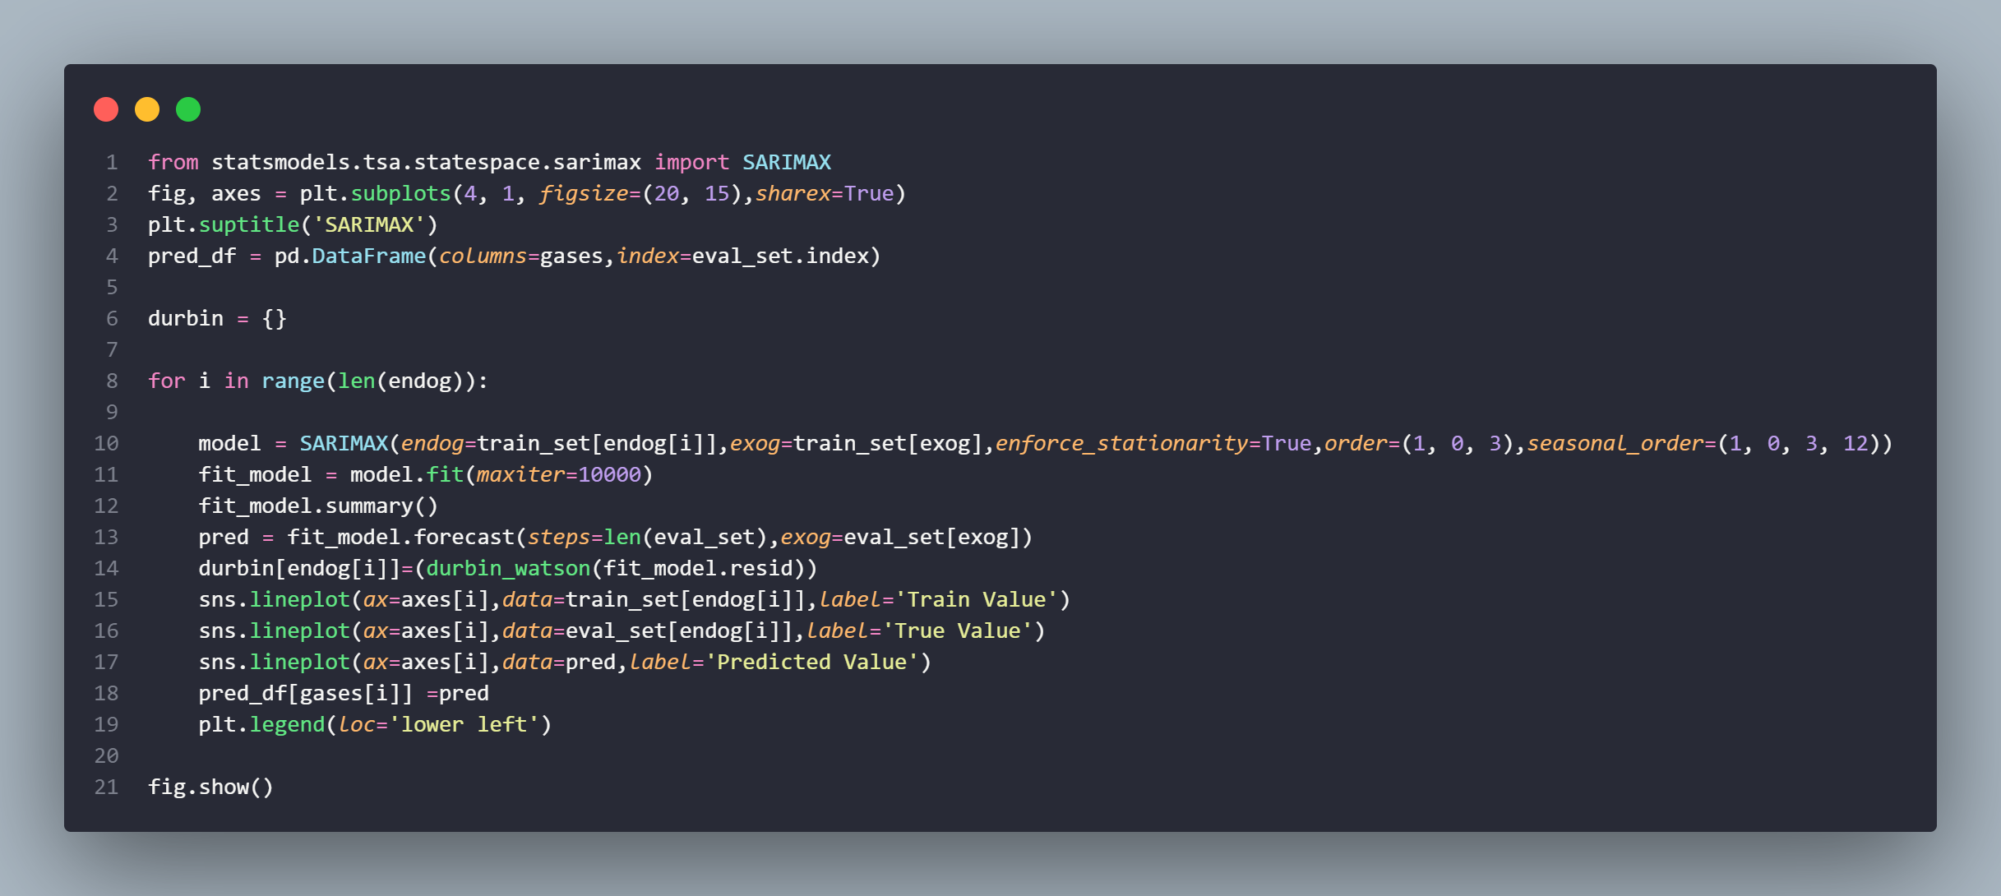
Seasonal Auto-Regressive Integrated Moving Average with eXogenous factors (SARIMAX)
Singapore Polytechnic
For the p,d,q values in the SARIMAX Model, I chose 1,0,3 respectively.
P: Maximum lag with a value out the confidence intervals D: Check whether the seasonal component is stationary or not Q: Maximum lag with a value out the confidence intervals
Singapore Polytechnic

Slide 31
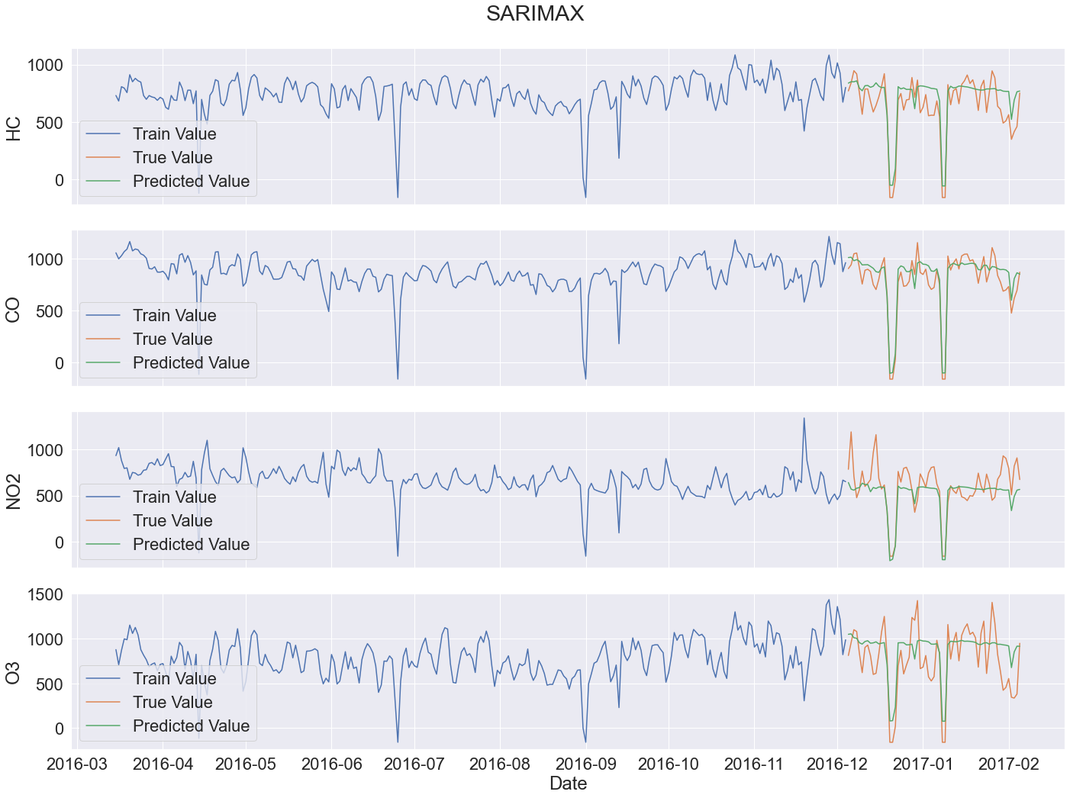
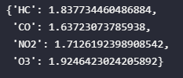
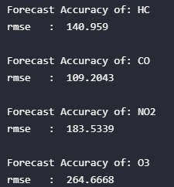
Singapore Polytechnic
Durbin-Watson Test Statistic
RMSE
We can observe the RMSE of CO is good, with it being below 110.
HC comes in at a close second, with the RMSE being 140.
However, NO2 and O3 are not so good on the SARIMAX Model, with the RMSE being above 190 for both.

Slide 32
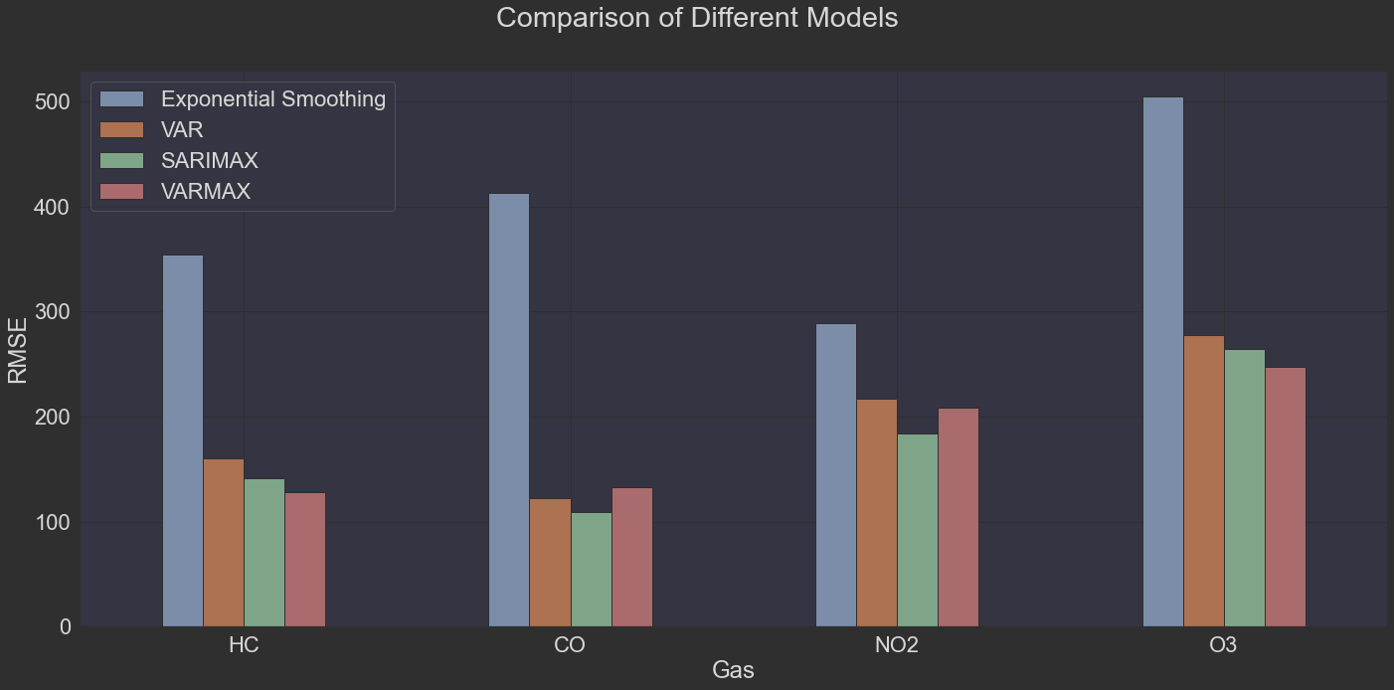
Model Analysis
Singapore Polytechnic
We can see that each model performs differently based on the gas.
Therefore, we will the model with the least RMSE for each gas.
HC: VARMAX
CO: SARIMAX
NO2: SARIMAX
O3: VARMAX
Singapore Polytechnic

Slide 33
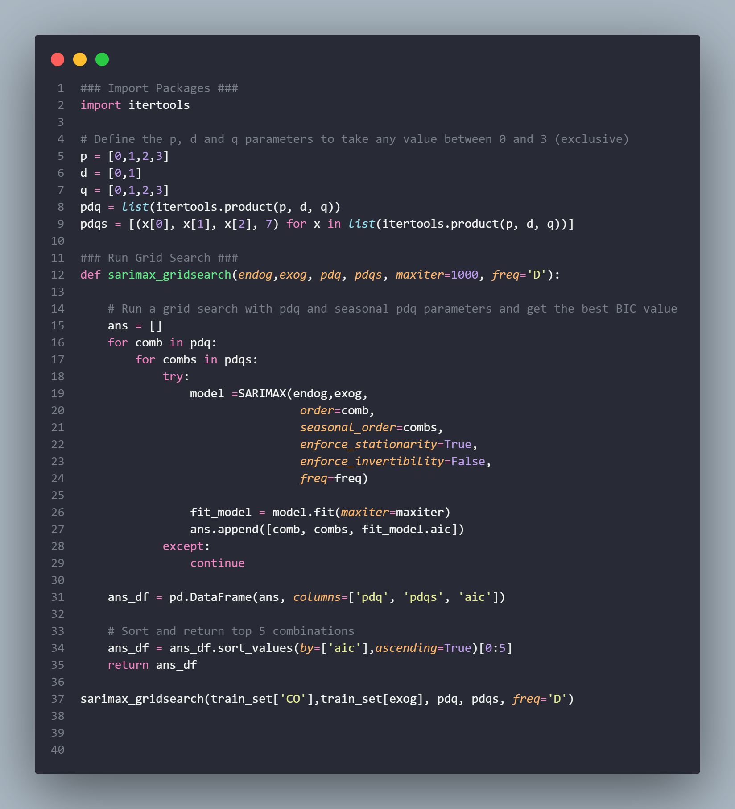
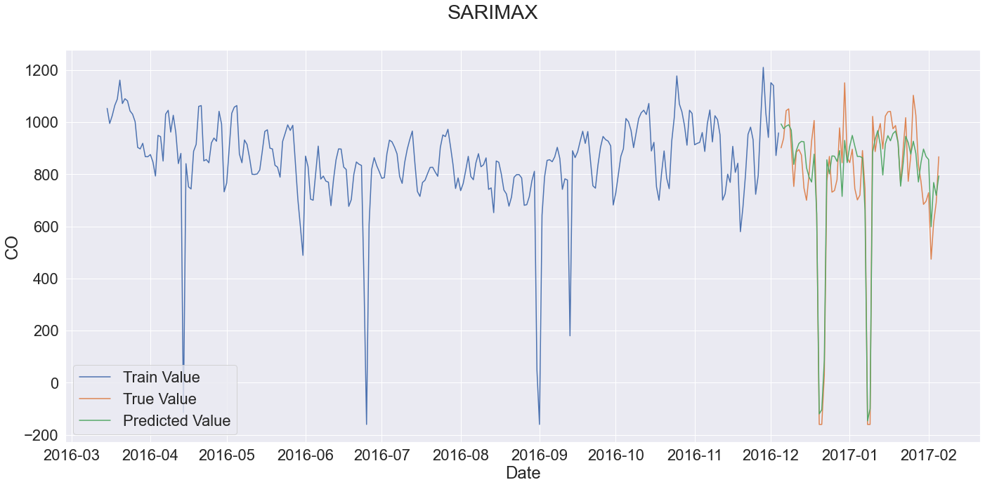
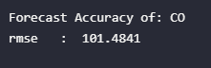
SARIMAX (Hyperparameter Tuned)
Singapore Polytechnic
After hyperparameter tuning, we can see that the RMSE for `CO` is `101.5`.
This reduced the RMSE from `109` to `101`.
As such, we will keep the new parameter values:
`order` = `(1, 0, 0)`
`seasonal_order` = `(3, 0, 1, 7)`
Singapore Polytechnic

Slide 34
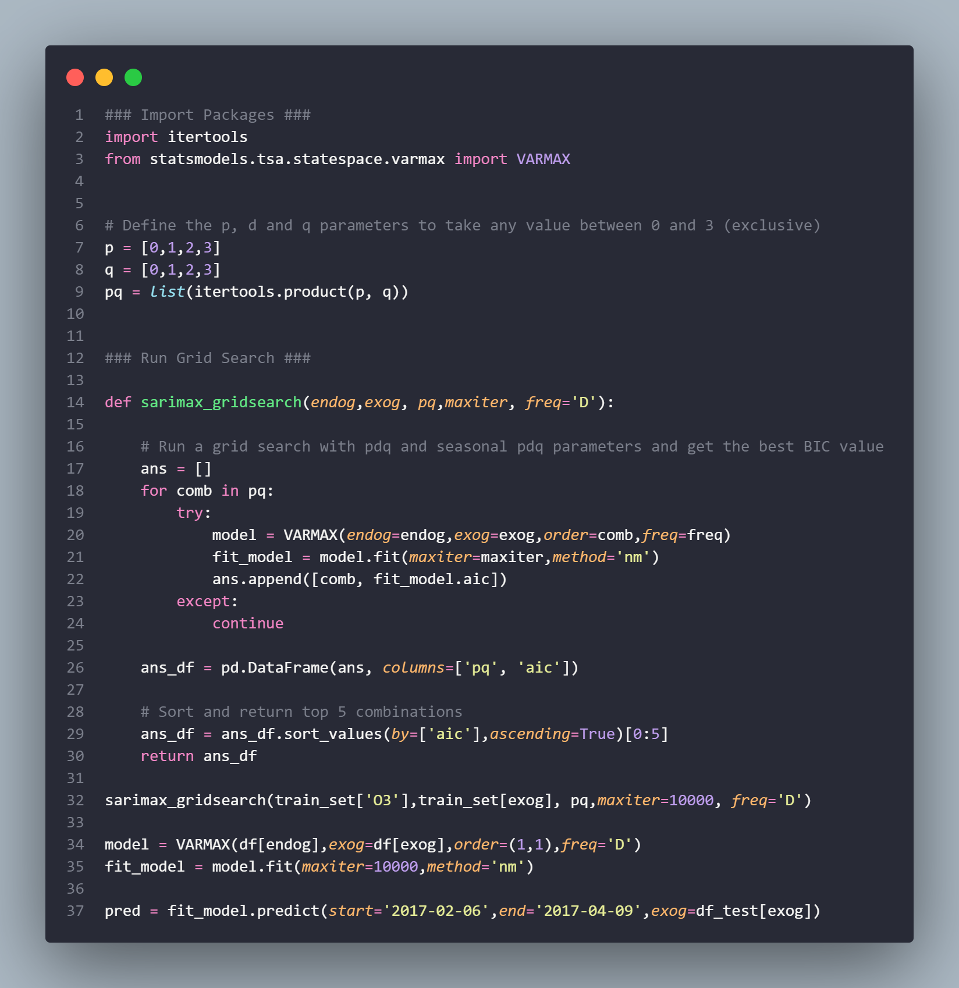
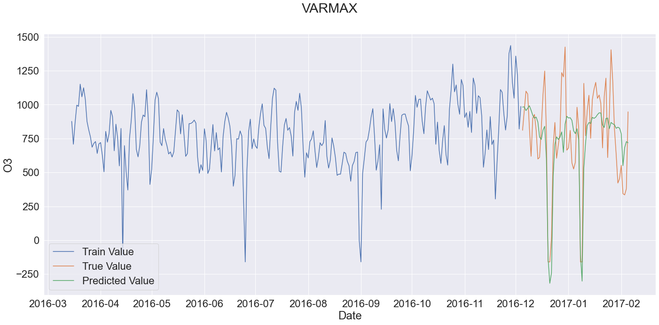
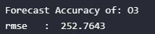
VARMAX (Hyperparameter Tuned)
Singapore Polytechnic
After hyperparameter tuning, we can see that the RMSE for `O3` is `252.7`.
This did not reduce the RMSE from `247`.
As such, we will *not* keep the new parameter values:
`order` = `(1, 3)`
Singapore Polytechnic

Slide 35
04.
Conclusion
Singapore Polytechnic
Conclusion of Insights
Singapore Polytechnic

Slide 36
Conclusion
Singapore Polytechnic
We used 2 types of models:
VARMAX
SARIMAX
The results from the hyperparameter tuning of SARIMAX reduced the RMSE by an average of 30, whereas the results from the hyperparameter tuning of VARMAX increased the RMSE by 10, hence I did not include it.
HC: 128.85
CO: 101.4841
NO2: 171.4
O3: 252.7
Therefore, we can see that the model performs well with HC and CO gases, but the unpredictability in the trends and seasonality of the NO2 and O3 data present a challenge for both the SARIMAX and VARMAX models.
Singapore Polytechnic

Slide 37
Singapore Polytechnic
Citations
Damos, P. (2016). Using multivariate cross correlations, Granger causality and graphical models to quantify spatiotemporal synchronization and causality between pest populations. BMC Ecology, 16(1). doi:10.1186/s12898-016-0087-7. [Accessed 4 Jul. 2022]
Jie, T. (2021). Time Series Analysis with Statsmodels. [online] Medium. Available at: https://towardsdatascience.com/time-series-analysis-with-statsmodels-12309890539a [Accessed 4 Jul. 2022]
US EPA,OAR (2016). Nitrogen Dioxide (NO2) Pollution | US EPA. [online] US EPA. Available at: https://www.epa.gov/no2-pollution [Accessed 21 Jul. 2022].
Duan, Y., Liu, X., Li, H., Yan, S., Yan, M., Mang, Y. and Yin, P. (2019). Season and temperature modify the short-term effect of nitrogen dioxide on cardiovascular mortality: a time-series study. The Lancet, [online] 394, p.S57. doi:10.1016/s0140-6736(19)32393-1. [Accessed 21 Jul. 2022].
Rajan, S. (2021). Multivariate Time Series Anomaly Detection using VAR model. [online] Analytics Vidhya. Available at: https://www.analyticsvidhya.com/blog/2021/08/multivariate-time-series-anomaly-detection-using-var-model/ [Accessed 12 Aug. 2022].
Defaux, C. (2020). Using the Durbin-Watson (DW) test for time-series data. [online] Medium. Available at: https://medium.com/@cdefaux/using-the-durbin-watson-dw-test-for-time-series-data-b87bd884fbbd [Accessed 12 Aug. 2022].
Singapore Polytechnic

Slide 38
Thanks!
Singapore Polytechnic
Do you have any questions?
Please keep this slide for attribution
Singapore Polytechnic

